Slide 1
Natural Language Understanding
in Dialogue Systems
Ciobanu Sergiu-Tudor, Moga Patricia

Slide 2
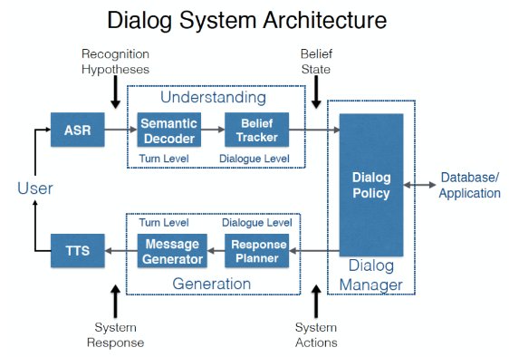
Introduction in Dialogue Systems
Definition: a Computation System designed to interact with users in (spoken) natural language
Basic Dialogue System Types​
Task-oriented: focused on certain tasks (e.g. booking restaurants/flights, smart home...)
Non-task-oriented: entertainment, social interactions
voice -> text
text -> meaning
meaning -> reaction
reaction -> text
text -> voice
Basic Dialogue System Types​
Traditional DS Pipeline
Ciobanu Sergiu-Tudor

Slide 3
Natural Language Understanding
• words -> meaning: Extracting meaning from the user utterance
• converting into a structured semantic representation
• earlier: syntax trees, predicate logic, graphs
• Dialogue Acts: intent + slots & values
NLU as Classification
• set of semantic concepts
• binary classification: is concept Y contained in utterance X?
• independent for each concept
NLU as Sequence Tagging
• get slot values directly: each word classified
• classes = slots & IOB format
• independent for each concept
Ciobanu Sergiu-Tudor

Slide 4
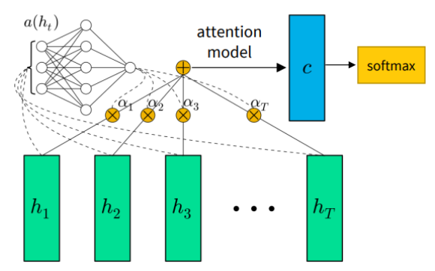
Intent Classification and Slot Tagging
Goal: Turning raw text into a structured Dialogue Act.
Method: Intent (Global Goal) + Slots (Specific Details)
Tech: Attention helps the model focus on key words
The Flaw: Rigidity and OOV (Fails when it sees new words)
Old Fix: Delexicalization (Using placeholders like "location")
Moga Patricia

Slide 5
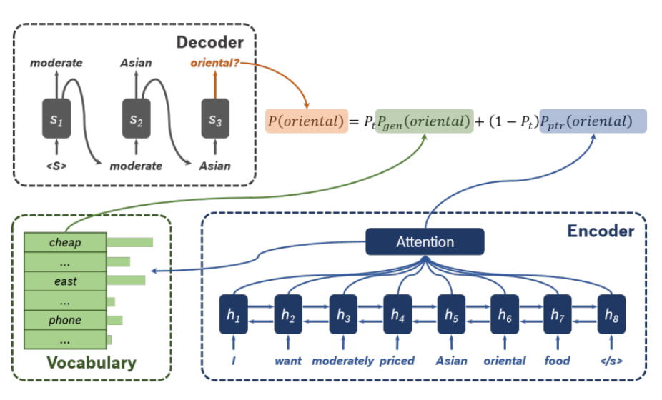
Sequence2Sequence
The Concept: Moving from labeling to "translating" input into semantic frames
The OOV Solution: Using a Pointer-Generator to handle unknown words
The Hybrid Mechanism:
Generate: Pick a word from the fixed vocabulary
Copy: Point to and copy a word directly from the input
Technical Components:
Encoder: Processes the input sequence
Attention: Focuses on relevant parts of the text
The Switch: A learnable variable that balances generating vs. copying.
Moga Patricia

Slide 6
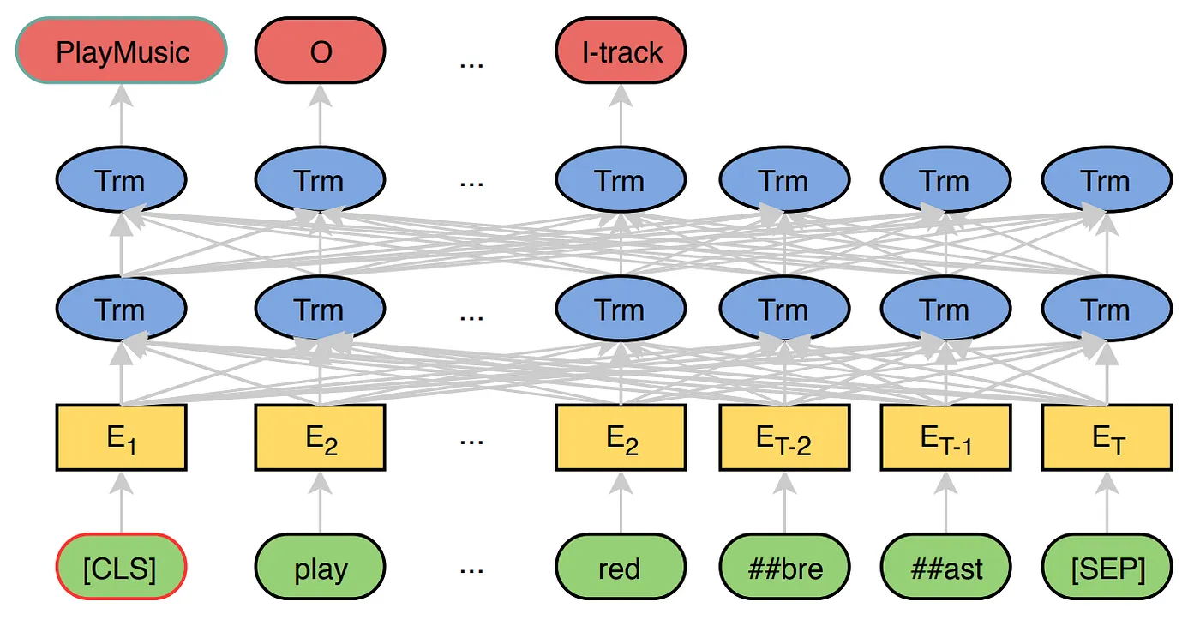
JointBERT
• Joint Intent Classification and Slot Filling
• Hidden States for Tokens
• Minimizing Cross Entropy
• Maximizing Cond. Probability
Ciobanu Sergiu-Tudor

Slide 7
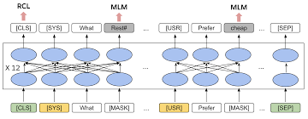
ToD-BERT
• Motivation: standard BERT lacks conversational logic
• Data Scale: Pretrained on 100k dialogues / 60 domains; utilizes human to human datasets
• to capture speaker information and the underlying interaction behavior in dialogue
• Masked language modeling (MLM): tokens replaced with masked tokens; a cross entropy loss
• Response Contrastive Loss (RCL): ranks responses through dual-encoder and in-batch negatives
Ciobanu Sergiu-Tudor

Slide 8
Evaluating NLU Performance
The Metric: F1-score (balancing Precision and Recall).
The Method: Using sequence-based simulators to mimic real human behavior.
Key Findings:
Context matters: Models that remember conversation history perform better.
Flexibility: Topic-independent models are easier to adapt to new areas.
Complexity: Relation-centric models stay accurate even when the input is difficult.
Moga Patricia

Slide 9
Conclusion
The NLU Journey: Transitioning from rigid, rule-based systems to flexible, generative architectures.
The Modern Shift: Moving toward end-to-end processes that utilize Large Language Models as a "single network for everything".
Key Trade-offs:
End-to-End: Offers joint optimization via backpropagation and reduces error accumulation.
Modular: Remains relevant for its superior explainability and ease of debugging.
The Future: Balancing deep contextual intelligence with the high precision needed for task-oriented applications.
Moga Patricia

Slide 10
Bibliography
[1] Zefan Cai, Xin Zheng, Tianyu Liu, Haoran Meng, Jiaqi Han, Gang Yuan, Binghuai Lin, Baobao Chang, and Yunbo Cao. DialogVCS: Robust natural language understanding in dialogue system upgrade. In Proceedings of the 2024 Conference of the North American Chapter of the Association for Computational Linguistics: Human Language Technologies (Volume 1: Long Papers), Stroudsburg, PA, USA, 2024. Association for Computational Linguistics.
[2] Qian Chen, Zhu Zhuo, and Wen Wang. Bert for joint intent classification and slot filling, 2019.
[3] Jacob Devlin, Ming-Wei Chang, Kenton Lee, and Kristina Toutanova. Bert: Pre-training of deep bidirectional transformers for language understanding, 2018. [4] Jianfeng Gao, Michel Galley, and Lihong Li. Neural approaches to conversational AI. September 2018.
[5] Dilek Hakkani-T¨ur, Gokhan Tur, Asli Celikyilmaz, Yun-Nung Chen, Jianfeng Gao, Li Deng, and Ye-Yi Wang. Multi- domain joint semantic frame parsing using bi-directional RNN-LSTM. In Interspeech 2016, ISCA, September 2016. ISCA.
[6] Shengpeng Ji, Yifu Chen, Minghui Fang, Jialong Zuo, Jingyu Lu, Hanting Wang, Ziyue Jiang, Long Zhou, Shujie Liu, Xize Cheng, Xiaoda Yang, Zehan Wang, Qian Yang, Jian Li, Yidi Jiang, Jingzhen He, Yunfei Chu, Jin Xu, and Zhou Zhao. Wavchat: A survey of spoken dialogue models, 2024.
[7] Bing Liu and Ian Lane. Attention-based recurrent neural network models for joint intent detection and slot filling. September 2016.
[8] Colin Raffel and Daniel P W Ellis. Feed-forward networks with attention can solve some long-term memory problems. December 2015.
[9] Owen Rambow, Srinivas Bangalore, and Marilyn Walker. Natural language generation in dialog systems. In Proceed- ings of the First International Conference on Human Language Technology Research, HLT ’01, page 1–4, USA, 2001. Association for Computational Linguistics.
[10] Lin Zhao and Zhe Feng. Improving slot filling in spoken language understanding with joint pointer and attention. In Iryna Gurevych and Yusuke Miyao, editors, Proceedings of the 56th Annual Meeting of the Association for Com- putational Linguistics (Volume 2: Short Papers), pages 426–431, Melbourne, Australia, July 2018. Association for Computational Linguistics.

